Slide 1
Bias Results December 2016
Jessica Snyder

Slide 2
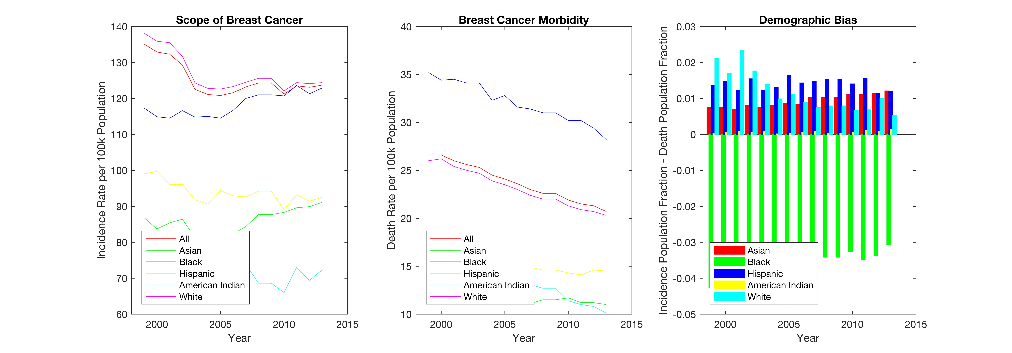
Rationale

Slide 3
Comparison, with and without unknowns
Incidence
Count
Death
Count
Cell Line
Publication Record
Incidence
Count
Death
Count
Cell Line
Publication Record
Incidence
Count
Death
Count
Cell Line
Publication Record
Incidence
Count
Death
Count
Cell Line
Publication Record

Slide 4
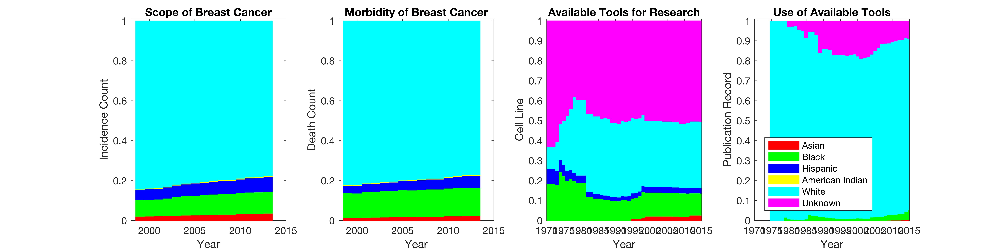
Timeline

Slide 5
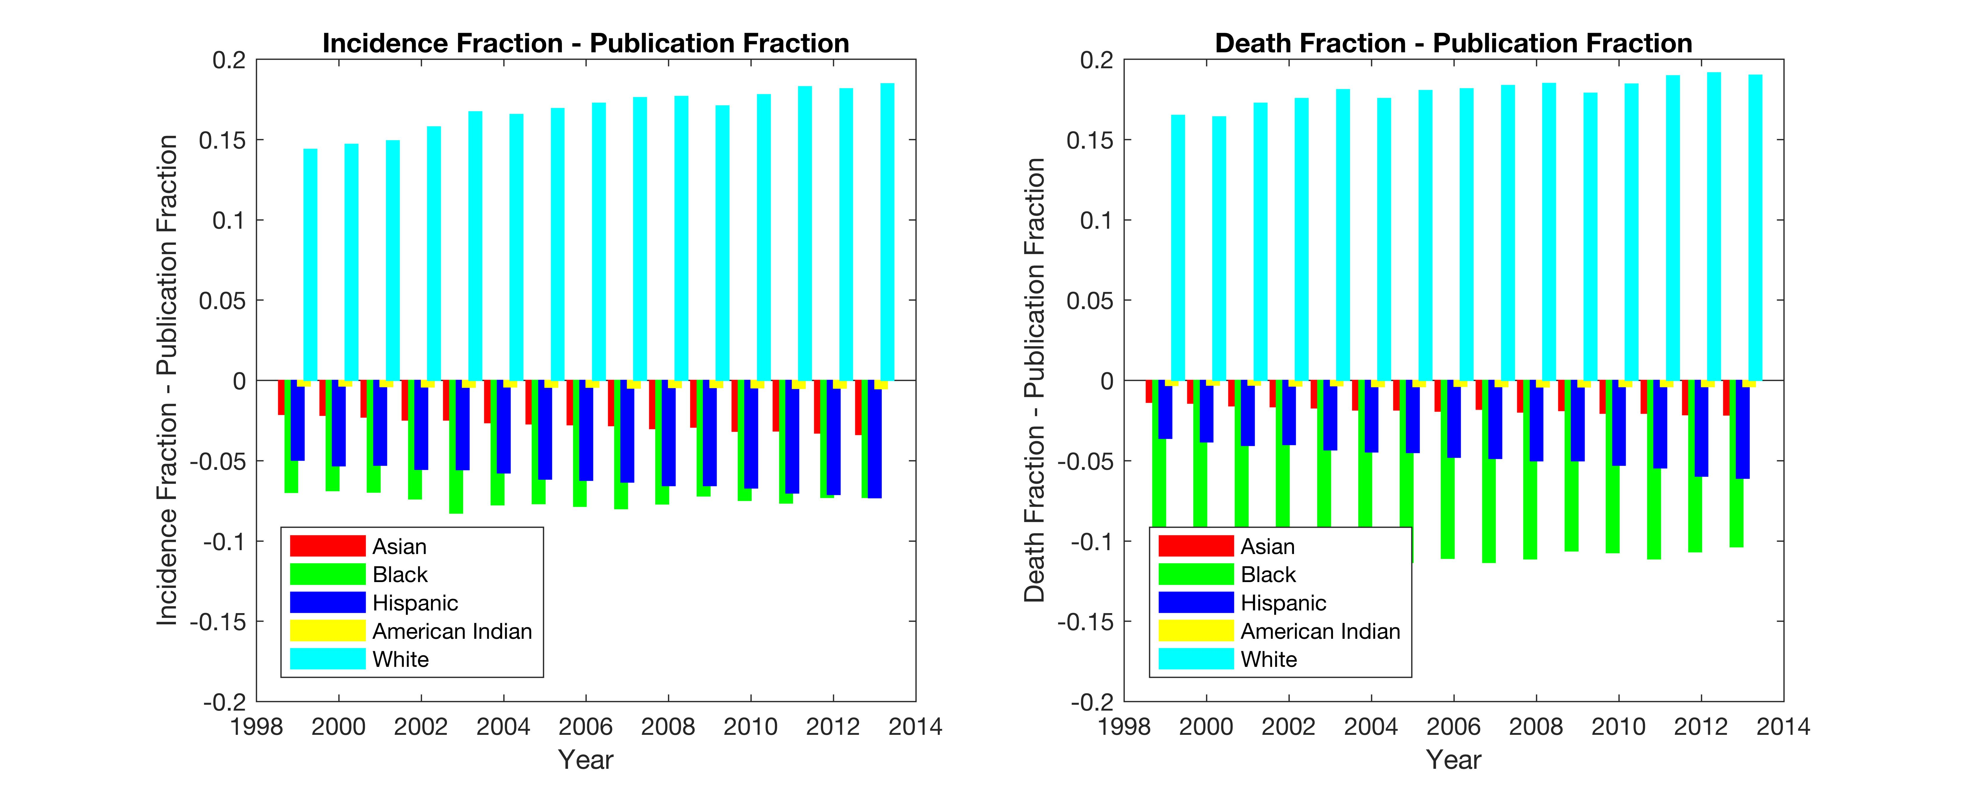
Bias

